Slide 1
New Hire Orientation FAQs
Human Capital Office
Payroll and Personnel Systems

Slide 2
Table of Contents
Section 1: Leave
Section 2: Pay
Section 3: Employee Personal Page (EPP)
Section 4: Thrift Savings Plan (TSP)
Section 5: Retirement-Mandatory (CSRS & FERS)
Section 6: Military
Section 7: Health Insurance
Section 8: BENEFEDS/Supplemental Insurance
Section 9: Life Insurance

Slide 3
FAQs
Section One (1): Leave

Slide 4
Section 1: Leave
If I have prior federal government service and was accruing 6/8 hours per pay period how long before my accruals are updated to that again?
Once your personnel folder (OPF) is received, all prior service will be calculated, and your Service Computation Date (SCD) verified.
- This process can take more than 120 days.
You can submit your last Statement of Earnings and Leave (SEL) to the Data Integrity Office for an expedited service if you have leave transferring with you. Submit to opf.con.site@irs.gov.
If you do not receive an update within 120 days, open a service request through IRS Service Central. (Slide 64 & 65)

Slide 5
Section 1: Leave
You said as new hires we accrue 4 hours of annual leave per pay period. Does this amount increase?
Once you complete 3 years of federal service your annual leave increases to 6 hours per pay period and once you complete 15 years of service your leave accrual increases to 8 hours per pay period. Further information on annual leave and accrual rates can be found here: Annual Leave (Slide 18)
Does the sick leave accrual increase as well?
No.

Slide 6
Section 1: Leave
Does the agency offer Short-term disability insurance?
No, but we do have the benefit of Paid Parental Leave (PPL). For more information and qualifications please refer to: https://irssource.web.irs.gov/Lists/Timekeeping/DispItemForm.aspx?ID=99 (Slide 19)
Who approves our time off requests? How do we request time off?
All leave requests and approvals go through your manager.

Slide 7
Section 1: Leave
I had leave when I left my prior agency. How do I make sure that those get transferred with me?
The leave is transferred with your OPF. Once the information is verified the leave balances will first show in SETR, then your Statement of Earnings and Leave (SEL). This process can be expedited by submitting your last SEL from your prior agency to our Data Integrity Office via fax to 855-875-6605 or email to opf.con.site@irs.gov (Slide 18)

Slide 8
Section 1: Leave
What happens to our leave if we leave the agency or retire?
When you separate from federal service, regardless of the type of separation a lump-sum payment for unused annual, compensatory and/or credit leave is dispersed. There is no payment for unused sick leave.

Slide 9
FAQs
Section Two (2): Pay

Slide 10
Section 2: Pay
When are we going to be paid?
Employees are paid on a bi-weekly basis. The date you receive your first paycheck depends on the day you started with the agency.
-The official pay day is two weeks after the end of the pay period. The pay period timeframes and pay dates are located on the 2024 Pay Calendar (Slide 17)

Slide 11
Section 2: Pay
Are we able to receive paper checks?
No.
I sent in a direct deposit form during onboarding. If I want to ensure you have my correct information before pay day, can I access the Employee Personal Page to verify?
The Employee Personal Page will not be available to you until after your first paycheck. Contact Payroll via an IRS Service Central ticket and our representatives can confirm your direct deposit information.

Slide 12
Section 2: Pay
If I am a current IRS employee who is just starting a new position, do I need to submit new direct deposit information?
No.
Is it possible to have my pay adjusted based on my prior government time?
Pay is set by the Employment office. You can contact the hiring official who did your onboarding, however, adjustments in pay are generally made once your prior Official Personnel Folder (OPF) is received. If, after 60 days, your pay has not been adjusted for prior federal experience, please open an IRS Service Central ticket.

Slide 13
Section 2: Pay
Where can I find my hourly rate? I was only told my annual salary.
Annual pay and hourly rates are located on the Office of Personnel Management website.
Can I set up portions of my paycheck to go to a separate account?
Yes. You can set up financial or discretionary allotments through the Employee Personal Page. A financial allotment is deposited each pay period just like your paycheck. A discretionary allotment is split into 2 payments, one half being deducted and held the first pay period of the month, the second half deducted the second pay period of the month, then the full payment is sent to the third party. Further clarification is available on EPP.

Slide 14
Section 2: Pay
I live in a state different from my Post of Duty (POD), can I have taxes withheld for my resident state?
To change your state tax withholding from one state to another, open an IRS Service Central request. In the search bar type “state taxes,” select the “State Tax Waiver” option. You will be asked, “Do you need to waive the state taxes you are currently paying to?” select “yes,” from the dropdown menu. Review the document link to see if your state has a reciprocal agreement. If your state has a reciprocal agreement, select “yes,” from the dropdown menu, complete the questionnaire and submit your ticket. If your state does not have a reciprocal agreement, select “no,” from the dropdown menu and provide detailed information regarding your request. An agent will contact you with further information to assist you. (Slide 59)

Slide 15
FAQs
Section Three (3):
Employee Personal Page (EPP)

Slide 16
Section 3: Employee Personal Page (EPP)
When can I set up my Employee Personal Page (EPP)? I tried to do it and it told me my information is not in the system.
EPP is not available until you have completed and been paid for your first pay period with the agency. At that time your information is submitted to the National Finance Center and your account will be established. (Slide 28)
I am transferring from another agency that also used EPP. Will I need to do anything to have my account updated?
Yes. You will need to call the Employee Resource Center (ERC) at 866-743-5748 and select Option 1, then Option 1 again. Request that a Doc 444 be submitted to update your account with the IRS information. (Slide 29)

Slide 17
Section 3: Employee Personal Page (EPP)
I am a transfer employee and have a TSP account already. Will a new account be created for me?
No, your account will transfer with you. Your prior agency will complete a TSP 19 and submit it to your new agency transferring your account.

Slide 18
FAQs
Section Four (4):
Thrift Savings Plan (TSP)

Slide 19
Section 4: Thrift Savings Plan (TSP)
If I had a prior 401K and want to roll that over to TSP can I do that?
Yes, with restrictions; contact TSP directly via their website www.tsp.gov or at 877-968-3778.
How do I find information on the TSP funds?
Information on the different investment funds can be located on the www.tsp.gov website or they can be discussed with a TSP representative at 877-968-3778.

Slide 20
Section 4: Thrift Savings Plan (TSP)
If I want to cancel/increase/decrease TSP deductions before I get access to my EPP account how do I do that?
Complete form TSP 1 and submit to Payroll via fax to 855-207-0459 or email to hco.hrss.phi.accessions@irs.gov (Slide 50)
Can we only change our TSP contribution amount at certain times?
No, you can update your TSP contributions at any time through EPP. (Slide 50)

Slide 21
Section 4: Thrift Savings Plan (TSP)
Do I get agency matching regardless of if my contributions are traditional or ROTH?
Yes, you will still receive matching. Agency contributions are made based on your election.
How does the TSP agency matching work?
The Agency contributes 1% automatically, without your election. The first 3% of pay you contribute will be matched dollar-for-dollar; the next 2% will be matched at 50 cents on the dollar. Contributions above 5% of your pay will not be matched. If you stop making regular employee contributions, your matching contributions will also stop, except the automatic 1%. (Slide 49)

Slide 22
Section 4: Thrift Savings Plan (TSP)
When will I be able to create/access my TSP account?
The TSP Service Office will send your account information through the mail. You will log into www.tsp.gov and create a user ID. (Slide 51)

Slide 23
FAQs
Section Five (5):
Retirement-Mandatory
(CSRS & FERS)

Slide 24
Section 5: Retirement-Mandatory (CSRS & FERS)
Can I change the amount deducted for my retirement?
No. These deduction amounts are based on a percentage of your income and set by law. (Slide 53)
I tried to create my GRB Platform account, but it is not allowing me to.
Your GRB account will be accessible after you receive your first salary check. You must use your work computer to establish your GRB account the first time, then you will be able to access your account from your home devices.

Slide 25
Section 5: Retirement-Mandatory (CSRS & FERS)
What happens to the money deducted for retirement if I leave the agency before retiring?
You have options; one would be to leave it there to withdraw later, the other would be to withdraw it shortly after your separation. Employees receive information, and instructions, regarding these options when they separate.
What happens if I am no longer able to work due to a disability?
You may qualify for a disability retirement. Information on disability retirements can be found at Types of Retirement or you can open an IRS Service Central ticket to speak with a retirement specialist.

Slide 26
Section 5: Retirement-Mandatory (CSRS & FERS)
Does the agency contribute to my retirement?
Yes, the agency contributes a percent to your retirement based on the retirement code you are hired under, currently 15.5%. https://www.opm.gov/retirement-services/publications-forms/benefits-administration-letters/2020/20-304.pdf.

Slide 27
FAQs
Section Six (6): Military

Slide 28
Section Six (6): Military
If I have prior military time and want to know if the deposit process will benefit me, how can I find that information?
Submit an IRS Service Central ticket for a Retirement Specialist to contact you. They will discuss the military deposit process and how it may benefit you. (Slide 66)
How does my Veteran’s Preference get updated?
Forward a copy of your Statement of Disability from the VA (if applicable) and a copy of your DD-214-member copy 4 to the OPF Con Site via fax to 855-875-6605 or email to opf.con.site@irs.gov.

Slide 29
FAQs
Section Seven (7):
Health Insurance

Slide 30
Section 7: Health Insurance
If I am covered under my spouse’s health insurance already. Do I need to send in any documentation?
No, you do not. Not sending in any documentation during the initial 60-day opportunity implies your intent to waive coverage.
I am a current employee starting a new position. Am I able to enroll because of this?
If your new position makes you eligible and you were not previously, yes. If you were previously eligible and elected not to enroll, no. If you did not enroll during your initial opportunity, you must wait until open season or experience a Qualifying Life Event (QLE) allowing you to enroll

Slide 31
Section 7: Health Insurance
How do I know what health insurance plan to enroll in?
All the plans available in your area, as well as costs and coverages, can be viewed on the Office of Personnel Management site using the FEHB Plan Comparison Tool.
I am a transfer from another agency, and I already had health insurance. Do I need to send in a form SF 2809 again?
No. Your SF 75 information includes the information necessary for transferring your coverage.

Slide 32
Section 7: Health Insurance
Where do I get the form SF 2809?
The health insurance enrollment is listed as a task on USA Staffing. You need to complete your enrollment there. DO NOT send a Form SF2809 after you have completed your enrollment in USA Staffing (Slide 36)
When will my health insurance coverage begin?
Coverage begins the first day of the pay period after your completed and correct forms are received. Be aware, it can take up to 60 days from the effective date for your selected provider to send you your welcome package and insurance cards. (Slide 40)

Slide 33
Section 7: Health Insurance
If I chose not to enroll during the initial 60 days, am I able to enroll in health insurance later?
Yes, during Open Season or when you experience a QLE. Open Season is an annual event that goes from the second Monday in November to the second Monday in December. A list of QLEs is on pages 6-9 on the instructions for form SF 2809.
I want to enroll in an insurance plan that has a Health Savings Account (HSA). How do I know which plans are eligible for that?
When using the FEHB Plan Comparison Tool there is a section that indicates if a plan is eligible for Health Reimbursement Arrangements (HRAs) or Health Savings Accounts (HSAs). The HSA/HRA is established by the provider you select so you can contact providers directly to request information on which account type you would be eligible for.

Slide 34
Section 7: Health Insurance
I have heard we can sign up for health insurance through EPP. Is this true?
EPP is used to make changes to current coverage and cannot be used for your initial enrollment.
Are there age limits for my children on the health insurance?
Yes, eligible dependents are covered by FEHB until they are 26, unless they are incapable of self-support. If you have a child over the age of 26 incapable of self-support, you need to submit a medical certification form with your enrollment.

Slide 35
Section 7: Health Insurance
If I have questions on specific plans and their coverages, can I contact Payroll?
Our staff is prohibited from advising employees regarding carriers and coverage. Specific questions on plans and coverages should be directed to the provider. The customer service numbers for each plan are located within the FEHB Plan Comparison Tool and brochure.
If I am not married, am I allowed to add my partner to the health insurance?
The Federal Employee Health Benefits (FEHB) Guide states a spouse from a valid common law marriage is an eligible family member for FEHB coverage. As an employee, it is your responsibility to be informed on your state’s regulations regarding common law marriages.

Slide 36
FAQs
Section Eight (8):
BENEFEDS/Supplemental Insurance

Slide 37
Section 8: BENEFEDS/Supplemental Insurance
If I had supplemental vision and dental insurance with BENEFEDS from my prior agency will those transfer with me?
Yes, but it requires you to contact BENEFEDS at www.benefeds.com or 877-888-3337 to inform them you have transferred agencies and request they transfer responsibility to the new agency.
If the health insurance plan that I select has dental and vision coverage is that the same as the BENEFEDS coverage?
No, Some FEHB plans include limited dental and vision coverage, but the coverage offered through BENEFEDS is supplemental coverage and requires an additional premium. BENEFEDS enrollment is not associated with your health insurance enrollment and is done via the BENEFEDS website. (Slide 42)

Slide 38
Section 8: BENEFEDS/Supplemental Insurance
Is there an age limit for children on the dental and vision insurance?
Yes. Eligible dependents include unmarried children under age 22 (including recognized natural children, adopted children, stepchildren, and foster children, if living with an employee or annuitant in a regular parent-child relationship) or children, any age, incapable of self-support due to mental or physical disability existing before age 22.
Where can I find the plans and costs for the Dental and Vision insurance?
Supplemental plans and premiums are on the Office of Personnel Management website via the FEDVIP Plan Comparison tool or on the BENEFEDS website.

Slide 39
FAQs
Section Nine (9):
Life Insurance

Slide 40
Section 9: Life Insurance
If I only want basic life insurance coverage, do I need to do anything?
No. You will be enrolled automatically once you are certified, and no form is required. (Slide 44)
If I choose not to keep the basic coverage or not enroll in the optional life insurance coverages can this be done later?
If you choose to waive coverage now, you will have to complete a physical at your cost, experience a QLE or wait for an open season (which is rare) to enroll or increase. (Slide 44)

Slide 41
Section 9: Life Insurance
Can you tell me exactly what the life insurance will cost me per pay period?
The life insurance premiums vary based on your age, salary, and multiples you elect. You can access the FEGLI calculator to determine the costs. (Slide 44 & 45)
Does the cost for the Option C Family Coverage go up for the number of covered family members?
No, the cost of Option C Coverage is based on your age, as well as the number of multiples you elect, not the number of eligible dependents.

Slide 42
Section 9: Life Insurance
Is there an age limit for children covered under Option C?
Yes, the FEGLI law defines eligible family members for Option C coverage as your spouse and your unmarried dependent children under age 22.
Do I have to submit beneficiary forms?
No, you are not required to submit beneficiary forms. If forms are not submitted the Federal Order of Precedence applies. Information on the Federal Order of Precedence is available on the OPM website; however, if at any time the Order of Precedence does not fit your circumstance, it is highly recommended you submit beneficiary forms.

Slide 43
Section 9: Life Insurance
Am I only able to waive the life insurance during the initial 60 days?
No, you can waive or reduce your life insurance coverage at any time.

Slide 44
Still Have Questions?

Slide 45
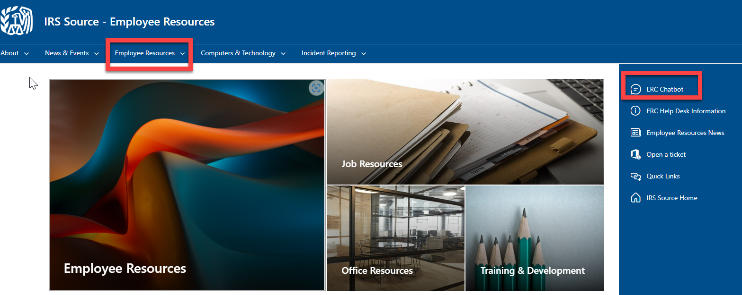
Still Have Questions?
If you have additional questions that have not been addressed during this presentation, you may find your answers by using the Chat Bot feature. On the IRS Source home page, click Employee Resources then ERC Chatbot.

Slide 46
Still Have Questions?

Slide 47
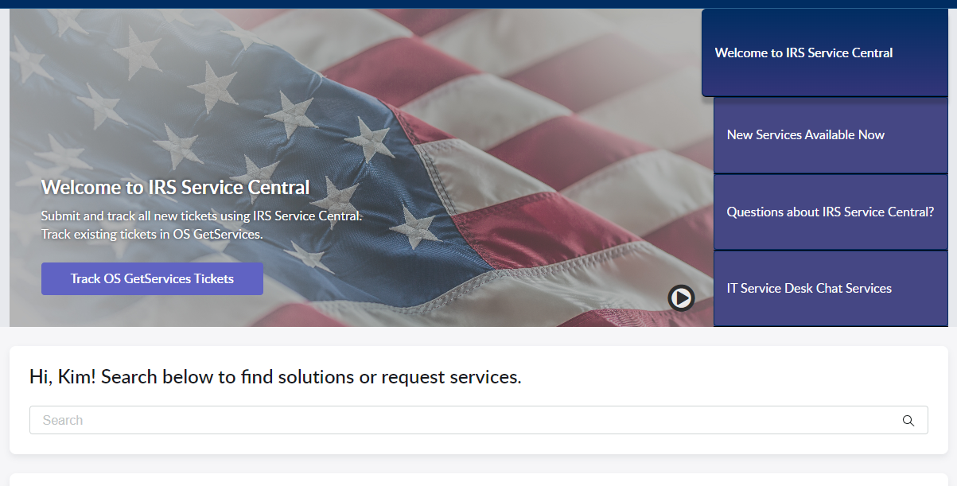
Still Have Questions?
Use IRS Service Central to submit tickets for services and repairs.

Slide 48
Still Have Questions?

Slide 49
Still Have Questions?
For Assistance call:
1-866-743-5748
1-800-877-8339 Federal Relay Service
Call Center Hours of Operation
Gate | Monday | Tuesday | Wednesday | Thursday | Friday
Payroll & Benefits Gate | 8:00a – 6:00p (ET) | 8:00a – 6:00p (ET) | 8:00a – 6:00p (ET) | 8:00a – 6:00p (ET) | CLOSED
Timekeeping / SETR Gate | 8:00a – 6:00p (ET) | CLOSED | CLOSED | 8:00a – 6:00p (ET) | 8:00a – 6:00p (ET)
On-line at:
IRS Service Central
Employee Center Pro Homepage - Employee Center (irs.gov)

